Slide 1
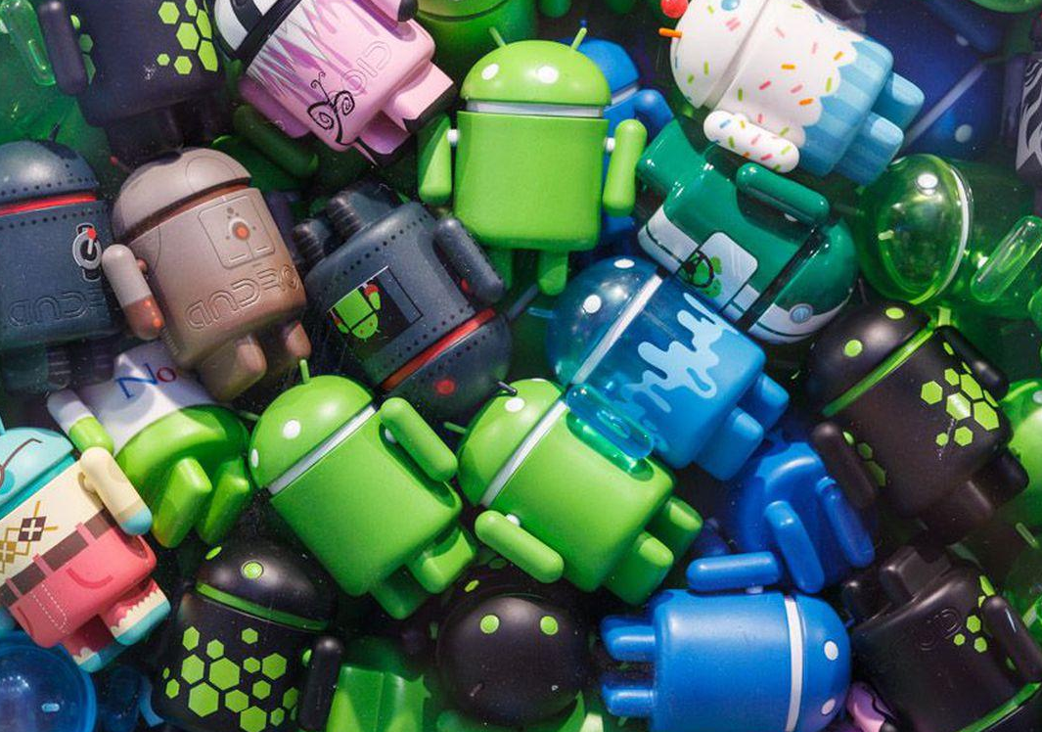
ABOUT PROJECT
Using the Accelerometer Sensor from the mobile
Moving Robots
Notes:
Note:
To Change the Picture and replace new one as same shape Follow the steps below
Select the picture first > Mouse Right button click>change picture>Browse and select the image from your computer>Click Insert
That’s it. You are Done !!!

Slide 2
Accelerometer Details
An accelerometer is a device that measures proper acceleration.
An accelerometer is an electromechanical device used to measure acceleration forces. Such forces may be static, like the continuous force of gravity.
The Android platform provides several sensors that let you monitor the motion of a device. ... The gravity, linear acceleration, rotation vector, significant motion, step counter, and step detector sensors are either hardware-based or software-based. The accelerometer and gyroscope sensors are always hardware-based
Moving Robots
Notes:
Note:
To Change the Picture and replace new one as same shape Follow the steps below
Select the picture first > Mouse Right button click>change picture>Browse and select the image from your computer>Click Insert
That’s it. You are Done !!!

Slide 3
PROJECT TIMELINE
01
Splash Screen
Custom Surface View
02
A splash screen may display start up progress to the user or to indicate branding
A surface view is a view in view hierarchy that has its own separate Surface
03
Showing Sensor Data
Moving The Robots
04
Shows the accelerometer sensor data when we move the device
Moves the robots inside the surface according to accelerometer sensor whenever we tilt the android device

Slide 4
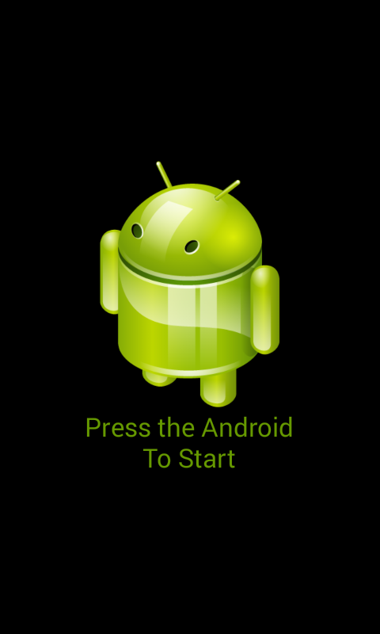
Screenshot
Splash
Screen
Notes:
Note:
To Change the Picture and replace new one as same shape Follow the steps below
Select the picture first > Mouse Right button click>change picture>Browse and select the image from your computer>Click Insert
That’s it. You are Done !!!

Slide 5

Screenshot
Custom
Surface
View
Notes:
Note:
To Change the Picture and replace new one as same shape Follow the steps below
Select the picture first > Mouse Right button click>change picture>Browse and select the image from your computer>Click Insert
That’s it. You are Done !!!

Slide 6
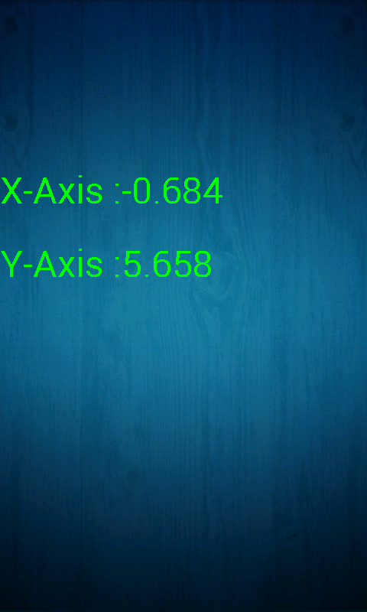
Screenshot
Showing
Sensor
Data
Notes:
Note:
To Change the Picture and replace new one as same shape Follow the steps below
Select the picture first > Mouse Right button click>change picture>Browse and select the image from your computer>Click Insert
That’s it. You are Done !!!

Slide 7
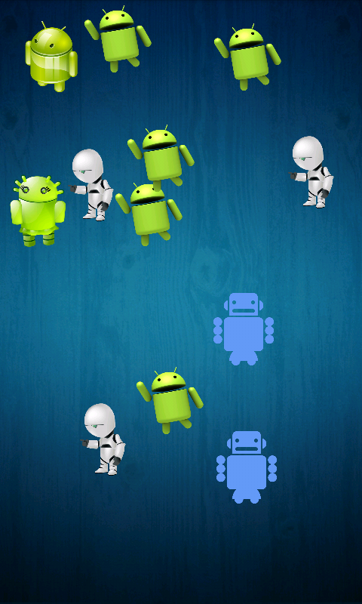
Screenshot
Moving
The
ROBOTS
Notes:
Note:
To Change the Picture and replace new one as same shape Follow the steps below
Select the picture first > Mouse Right button click>change picture>Browse and select the image from your computer>Click Insert
That’s it. You are Done !!!

Slide 8

PROJECT tools
Android Studio
Android Studio is the Official IDE for Android. Android studio provides the fastest tools for building apps on every type of Android device.
Notes:
Note:
To Change the Picture and replace new one as same shape Follow the steps below
Select the picture first > Mouse Right button click>change picture>Browse and select the image from your computer>Click Insert
That’s it. You are Done !!!

Slide 9

PROJECT tools
JAVA
JAVA is a high-level programming language originally developed by Sun Microsystems and released in 1995. Java runs on a variety of platforms, such as Windows, Mac OS, and the various versions of UNIX
Notes:
Note:
To Change the Picture and replace new one as same shape Follow the steps below
Select the picture first > Mouse Right button click>change picture>Browse and select the image from your computer>Click Insert
That’s it. You are Done !!!

